Slide 1
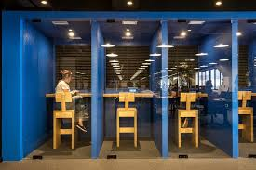
Capstone 3: olist ecommerce analysis
Insights for ecommerce in Brazil

Slide 2
olist
Ecommerce/marketplaces
Brazil
Founded in 2015
Mission: To connect merchants and products to main marketplaces via online e-commerce site

Slide 3
Task
Prepare
Clean data set for analysis
Explore
Perform exploratory analysis to identify high-level trends
Predict
Estimate cumulative 6 month revenue from a new customer
Interpret
Share insights
Identify next steps
Tools
Python
Excel
Numpy
Pandas
matplotlib.pyplot
statsmodels.formula.api
Notes:
Incomplete data - missing November 2016, incomplete 2018

Slide 4
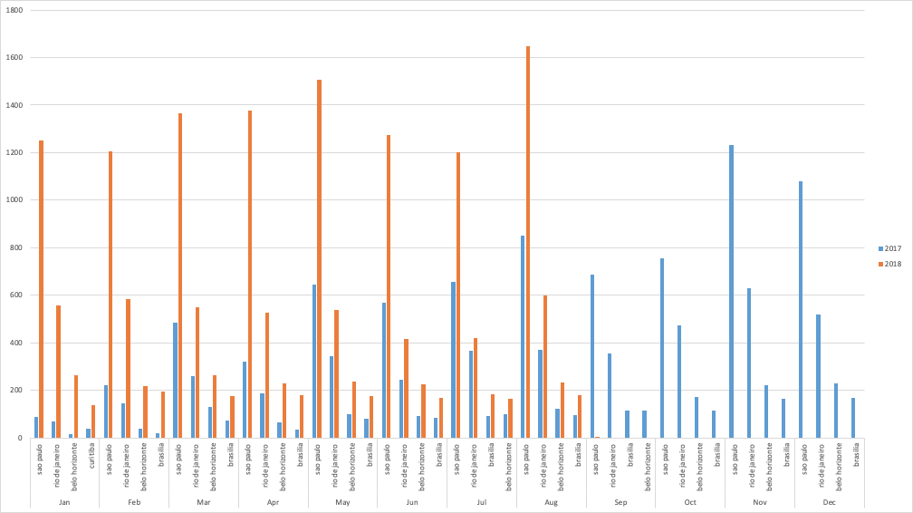
Total orders per month by city (1/2017 – 8/2018)
Notes:
If you have 30 customers, and the average amount paid per month is $50, your MRR is $150 and ARR is $1,800 (or $150 x 12.)

Slide 5
Total revenue and growth by city (1/2017-8/2018)
City | 2017 | 2018 | Total | Growth
Sao Paulo | 1,124,962.42 | 1,672,148.11 | 2,797,110.53 | 33%
Rio de Janeiro | 798,202.97 | 751,826.23 | 1,550,029.20 | -6%
Belo Horizonte | 204,419.09 | 289,157.61 | 493,576.70 | 29%
Brasilia | 185,638.65 | 240,165.95 | 425,804.60 | 23%
Curitiba | 130,592.68 | 191,572.67 | 322,165.35 | 32%
Porto Alegre | 135,976.66 | 163,737.53 | 299,714.19 | 17%
Salvador | 132,737.65 | 155,317.04 | 288,054.69 | 15%
Campinas | 116,714.81 | 147,215.19 | 263,930.00 | 21%
Guarulhos | 77,504.01 | 123,781.92 | 201,285.93 | 37%
Goiania | 111,029.86 | 87,187.45 | 198,217.31 | -27%
Other | 5,636,384.75 | 6,777,127.76 | 12,413,512.51 | 17%

Slide 6
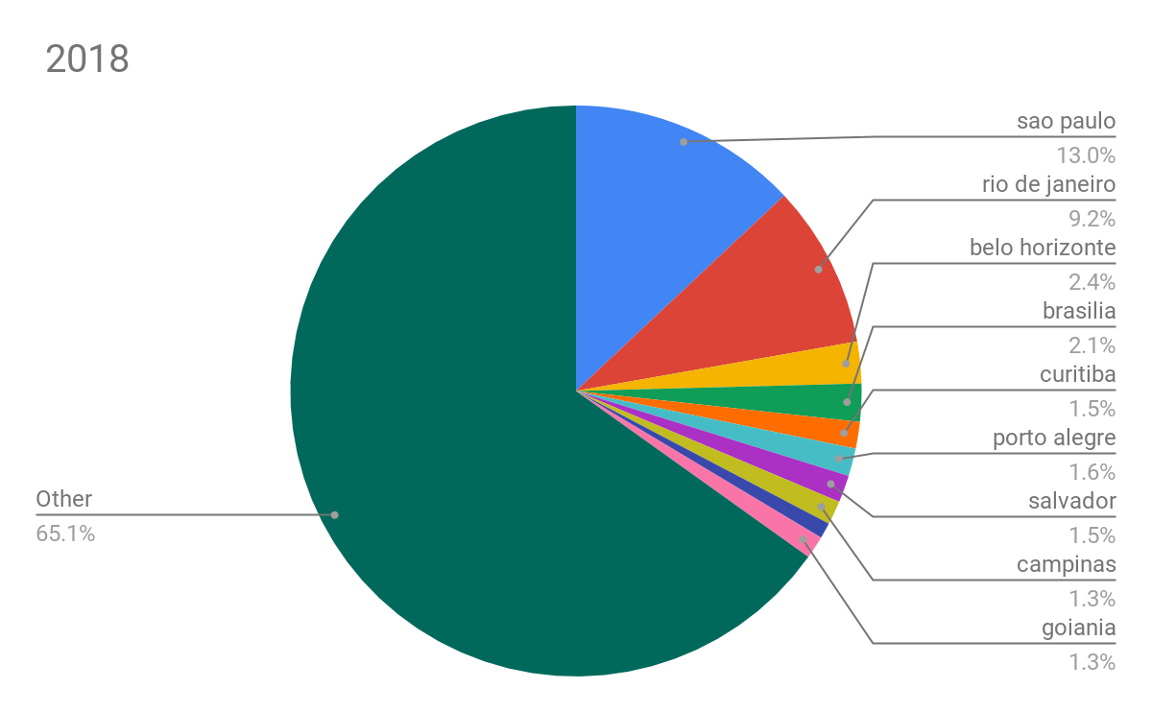
Revenue by city
CitySinS
São Paulo 13%
Rio de Janeiro 9%

Slide 7
Purchases by city
City | 2017 | 2018 | Growth
São Paulo | 7,583.00 | 10,831.00 | 30%
Rio de Janeiro | 3,964.00 | 4,188.00 | 5%

Slide 8
Revenue by city
City | 2017 | 2018 | Growth
São Paolo | 1,124,962.42 | 1,672,148.11 | 33%
Rio de Janeiro | 798,202.97 | 751,826.23 | (0.06%)

Slide 9
Monthly Recurring Revenue (MRR)
MRR is the monthly recurring revenue generated from new customers
Method: Average revenue per account method (ARPA)
Calculate the total revenue generated by all customers during the month
Determine the average monthly amount paid by all customers
Multiply the average by the total number of customers
MRR = ARPA * Total # of Customers
Notes:
Let's say you have 10 new customers in a month, half of them pay $50/month and the other half pays $100/month -- new MRR would be $750.P
n = number of months we want to calculate
n * n * .5 * MRR Growth

Slide 10
Monthly Recurring Revenue (MRR)
MRR = the sum of the payments for all customers during a 6 month period
How it works?
If you sold X amount from January - June 2017,
then assume sales would be the same from July - December
Notes:
For instance, if your team collectively sold $80,000 in monthly recurring revenue (MRR) in October, you'd assume they'd sell $80,000 or more in November.
Simple, but useful calculations to begin forcasting

Slide 11
olist: 6-month recurring revenue (Jan-Jun 2018)
City | Total Customers | Average payment per customer | Total Amount
São Paolo | 8261 | 70 | 581,302.65
Rio de Janeiro | 26989 | 47 | 1,255,947.70

Slide 12
Insights
There are greater implications for sales if this trend continue.
Why are some cities outperforming others?
Nearly 3x as many customers in Sao Paulo as in Rio yet population is only 2x larger
Why is growth in some major cities below the average rate?
Rio de Janeiro - 6% change
Goiania, Growth -27% change

Slide 13
Insights
City | Total Customers | Average payment per customer | Total Amount
São Paolo | 8261 | 70 | 581,302.65
Rio de Janeiro | 26989 | 47 | 1,255,947.70

Slide 14
Takeaways
Focus on Sao Paolo to identify factors contributing to higher growth
Take a step back and examine broader trends in Rio de Janeiro - competitors? Amazon Brazil?
Next steps: more python and predictive modeling

